Slide 1

Minor project Final review
IV YEAR, SEMESTER 7
Project Title: Toxic Comment Classification
Batch Number: A20 Guide Name: Mrs. S.Niveditha
Team Members: AJAY G (RA2111003040102)
ASHWATH AMUDHAN C A (RA2111003040103)
RAMACHANTHAR S (RA2111003040104)
14 – 11 - 2024

Slide 2
Abstract
The rise of user-generated content on online platforms has created a pressing need for automated systems that can identify and remove harmful language. DistilBERT, a smaller and faster variant of BERT, provides a trade-off between performance and computational efficiency. RoBERTa , known for its robustness and superior performance on a wide range of NLP tasks, serves as a comparative model to evaluate the effectiveness of DistilBERT in this context. Our experiments involve extensive preprocessing of textual data, fine-tuning of the models, and evaluation using metrics such as accuracy, precision, recall
14 – 11 – 2024

Slide 3
Motivation
Address the lack of context-awareness in traditional systems.
Foster a safer and more respectful online environment
14 – 11 – 2024

Slide 4
Literature Survey (Note: Minimum 10 Research papers must be attached)
S.No. | Title | Published Date | Publishers | Topic | Advantages | Disadvantages
1 | Impact of SMOTE on Imbalanced Text Features for Toxic Comments Classification Using RVVC Model | 25 May 2021 | IEE Explore | Toxic Comment Classification using BERT | Combining and BERT can enhance the model's ability to understand both context and sequence | Latency Issues: Real-time detection may face latency issues due to the computational demands of these models
2 | TOXIC COMMENT CLASSIFICATION | 5 May 2024 | IJCRT | Toxic Comment Classification, Machine Learning, Natural Language Processing | Leveraging advanced algorithms and techniques | Implement a variety of machine learning algorithms for toxic comment classification
3 | Pre-trained Language Models for Toxic Comment Classification | 19 Apr 2021 | White Rose Research Online | A comparative study of using pre-trained language models | RoBERTa generally achieves better performance on a range of NLP benchmarks compared to BERT. | Limited Contextual Understanding: DistilBERT may have a reduced ability to capture intricate contextual nuances due to its smaller size.
14 – 11 – 2024

Slide 5
Literature Survey (Note: Minimum 10 Research papers must be attached)
S.No. | Title | Published Date | Publishers | Topic | Advantages | Disadvantages
4 | Toxic Comment Classification using Transformers | 7 Nov 2021 | IEOM Society International | Toxic Comment Classification using BERT | RoBERTa improves upon BERT by optimizing the pretraining approach. | Scalability Issues: Some models require extensive computational resources, making them impractical for real-time applications
5 | Abusive_Language_Detection_on_Social_Media_using_Bidirectional_Long-Short_Term_Memory | 12 August 2015 | IEEE International Conference | Abusive_Language_Detection_on_Social_Media_using_Bidirectional_Long-Short_Term_Memory | It is a type of Recurrent neural network with extended features to overcome the problem of vanishing | Classification models may sometimes incorrectly label non-toxic comments as toxic (false positives) or fail to detect harmful comments
6 | Toxic Comment Detection using LSTM | 19 Apr 2021 | Third International Conference on Advances in Electronics,Computers and Communications (ICAECC) | A comparative study of using pre-trained language models | Detecting and filtering out toxic comments helps create a safe, positive, and inclusive space for all users, | Toxicity is often context-dependent. For example, sarcasm or friendly teasing might be flagged as toxic
14 – 11 – 2024

Slide 6
Disadvantages OF Existing System
High False Positives: Traditional keyword-based and rule-based systems often flag non-toxic comments as toxic.
Lack of Contextual Understanding: Many existing systems fail to understand the context in which words are used, leading to inaccurate detection.
Scalability Issues: Some models require extensive computational resources, making them impractical for real-time applications.
Limited Adaptability: Rule-based systems are rigid and cannot adapt to new slang or evolving language patterns
14 – 11 – 2024

Slide 7
Proposed System
The proposed system leverages the strengths of both RoBERTa and DistilBERT
for toxic comment detection. While RoBERTa achieves higher accuracy and F1-score, DistilBERT offers a more computationally efficient solution with comparable performance. This system aims to utilize DistilBERT as the primary model for large-scale deployment, ensuring efficient and scalable toxic comment detection without significant loss in accuracy. The findings underscore the potential of lightweight models like DistilBERT in real-world applications, where computational resources and latency are critical considerations. Future enhancements will focus on further optimizations and seamless integration of these models into automated content moderation systems.
14 – 11 – 2024

Slide 8
Goal
Achieve high accuracy in detecting nuanced toxic language through deep contextual understanding
Automatically detect and delete toxic comments to maintain a positive user experience.
14 – 11 – 2024

Slide 9
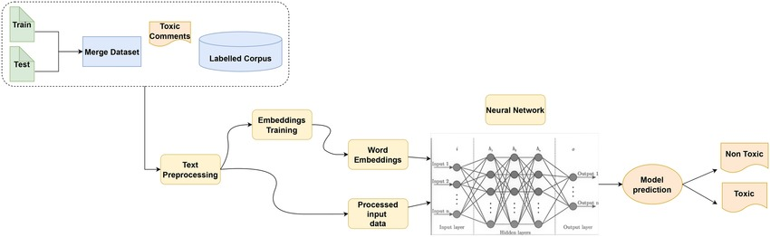
Architectural Diagrams
14 – 11 – 2024

Slide 10
Project Framework (Hardware / Software)
Hardware Local Machine: A computer with a modern CPUs (8 threads) and atleast Windows 10 or Above is suitable for development and training.
GPU: A dedicated GPU can significantly speed up the training process, especially for deep learning models. a GPU with at least 16GB of VRAM is recommended
Software
Operating System: Linux (Ubuntu, CentOS) or Windows
IDE/Text Editor: Visual Studio Code and Jupyter Notebook
14 – 11 – 2024

Slide 11
Modules (Explanation of Architectural Diagrams)
Data Sources
Purpose: Collect raw text data from platforms (social media, forums).
Examples:Jigsaw.
Data Preprocessing
Purpose: Clean and prepare data for analysis.
Tasks: Text normalization, tokenization, removing noise.
Data Implementation
Purpose: Gather data through scraping, APIs, or batch uploads.
Tools: Python scripts, API connectors.
14 – 11 – 2024

Slide 12
Algorithm Used
BERT (Bidirectional Encoder Representations from Transformers) :
Features: Contextual word embeddings, attention mechanisms.
Description: A transformer-based model pre-trained on a large corpus, capturing context from both directions for each word in a sentence.
DistilBERT :
Features: Distilled version of BERT, contextual word embeddings.
Description: A lighter and faster variant of BERT, retaining much of its performance while being more computationally efficient.
RoBERTa (Robustly optimized BERT approach) :
Features: Enhanced training techniques, contextual word embeddings
Description: An optimized version of BERT with improved training strategies, leading to better performance on various NLP tasks
14 – 11 – 2024

Slide 13
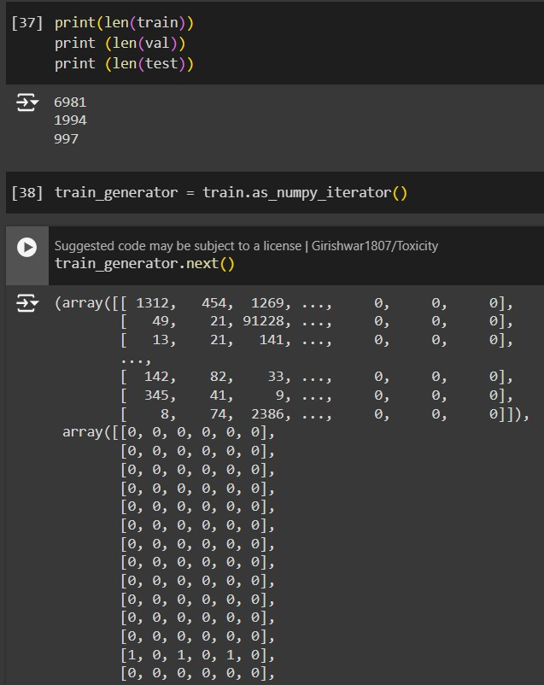
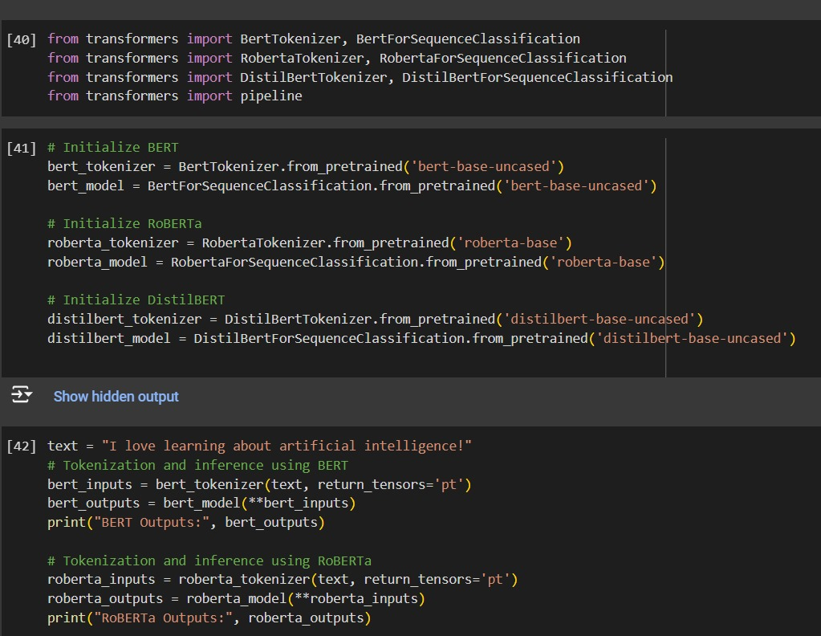
Module Implementation
14 – 11 – 2024

Slide 14
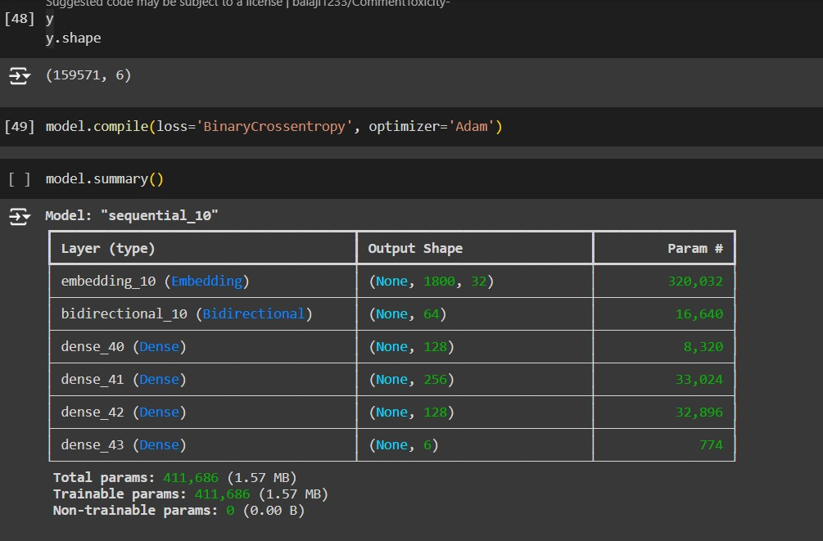
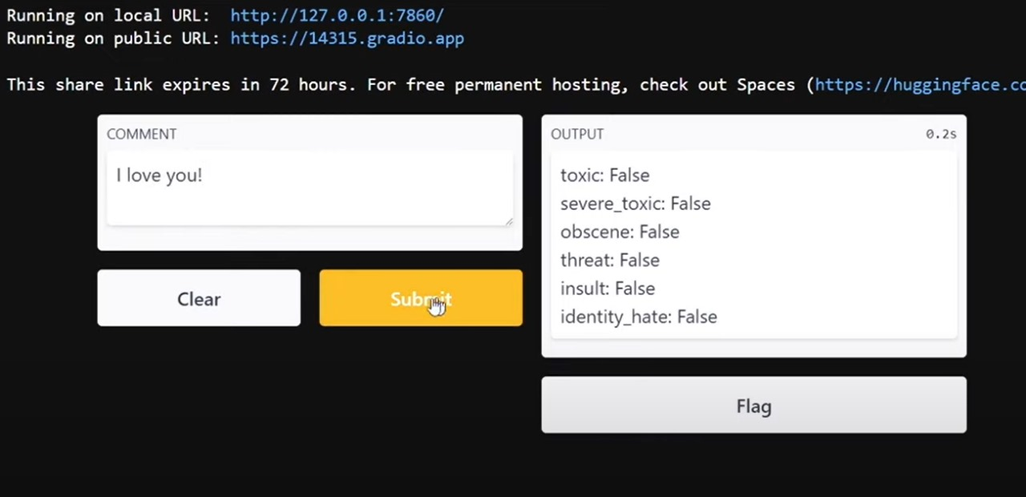
Module Implementation
14 – 11 – 2024

Slide 15
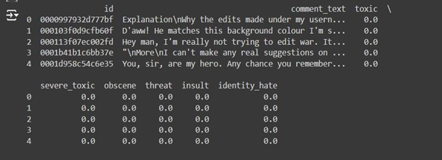
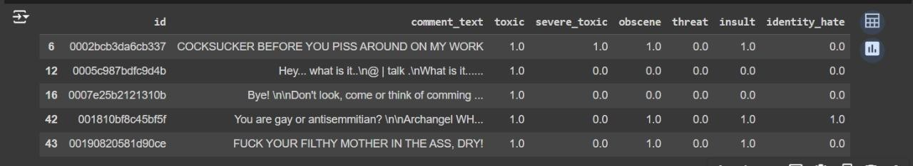
module 1 - Data Frames Module
It shows a portion of a dataset that includes columns for comment IDs, comment texts,and the classification of whether the comment is toxic or belongs to other specific categories like severe toxic, obscene, threat, insult, or identity hate
This part of the dataset contains more explicit and highly toxic comments, with corresponding values under columns such as severe_toxic, obscene, threat, insult, and identity_hate marked as 1 (indicating the presence of such traits).

Slide 16
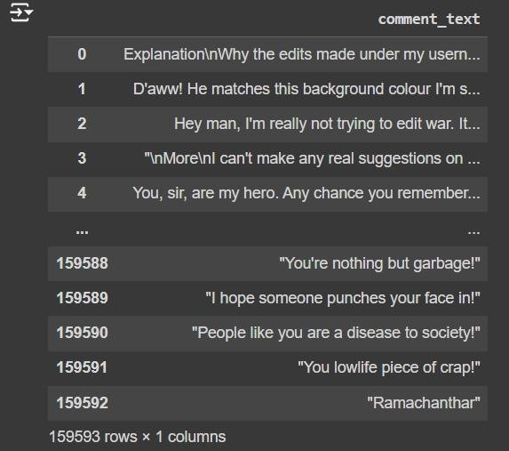
Module 2 - Train Data set Module
It shows a larger dataset with a focus on comment texts, ranging from neutral or non-toxic comments to toxic ones, where each row represents a specific comment

Slide 17
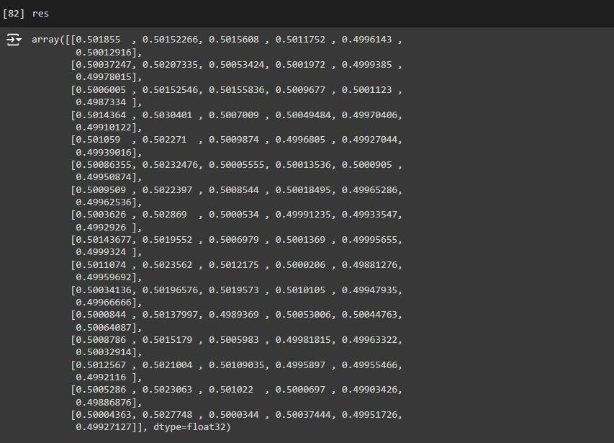
Module 3 - Text vectorizer Module
The dataset is likely being used for an NLP or machine learning model aimed at toxic comment classification.

Slide 18
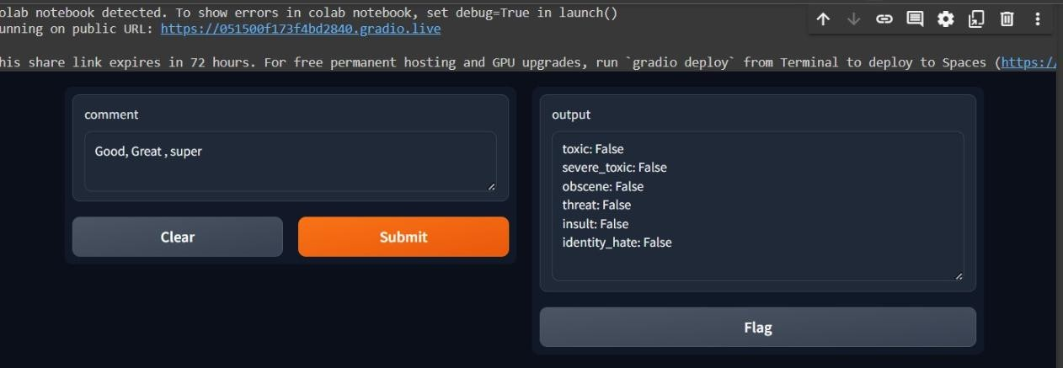
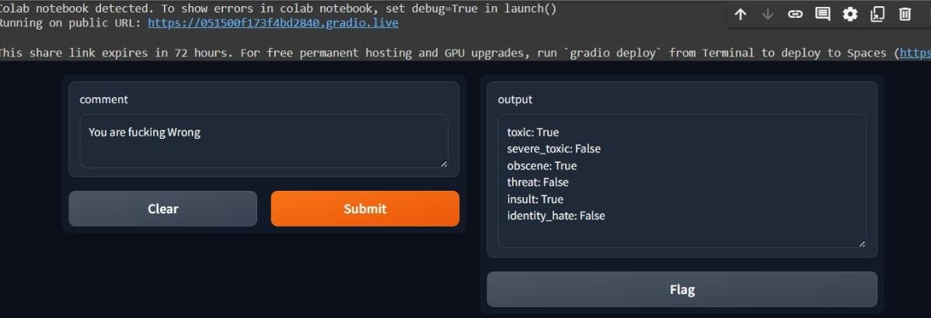
Module 4 - Gradio front end implementation
The Gradio interface showcases a comment input ("Good, Great, super") and the model's prediction, indicating that the comment is classified as non-toxic across all categories (toxic, severe_toxic, obscene, threat, insult, identity_hate).
The Gradio interface showcases a comment input ("Good, Great, super") and the model's prediction, indicating that the comment is classified as non-toxic across all categories (toxic, severe_toxic, obscene, threat, insult, identity_hate).

Slide 19



Conference certificate / patent proof / journal publications

Slide 20
Thank You !!!

